Slide 1
#SlamTheScam Campaign
NATIONAL SLAM THE SCAM DAY
MARCH 10, 2022
NATIONAL CONSUMER PROTECTION WEEK
MARCH 6 – 12, 2022

Slide 2
Help us #SlamTheScam
The Social Security Administration Office of the Inspector General is ready to #SlamTheScam for the third annual National Slam the Scam Day on March 10, 2022.
We’re partnering with Social Security Administration and other government agencies to raise public awareness of the pervasive government imposter scams that continue to plague the nation. In a government imposter scam, someone claims to be an SSA, or another government employee, and tells the caller there is a problem with their Social Security number, account, or benefits. Scammers may ask for personal information, demand payment, or make threats to resolve the fabricated issue. Scammers often require payment via retail gift card, cash, wire transfer, internet currency such as Bitcoin, or pre-paid debit card.
Slam the Scam Day is part of the larger National Consumer Protection Week, (NCPW) hosted by the Federal Trade Commission March 6 through 12, 2022.
The following slides will help your organization #SlamTheScam on social media during National Consumer Protection Week #NCPW and National Slam the Scam Day.

Slide 3
#SlamTheScam Campaign
Help get the word out by sharing #SlamTheScam content on your social media platforms.
Use the blank template and/or ready-to-share templates provided in the following slides. Feel free to create your own messaging, captions, or use our example captions for guidance.
Save the template slides as an image and share on social media platforms, such as Twitter, Facebook, or LinkedIn using the #SlamTheScam hashtag
Share #SlamTheScam content during National Consumer Protection Week, March 6—12, and beyond!

Slide 4
Social Media Templates
Choose your template. There are several options in the following slides.
1
Add your #SlamTheScam message. Add your agency’s logo in a template corner.
2
Use hashtags such as #SlamTheScam, #NCPW2022, and #NCPW
3

Slide 5
Example 1: Hang up or ignore suspicious calls, texts, or emails
Tweet/Post: If you receive a suspicious call, text, or email, hang up or do not respond. Government employees will NEVER threaten you or demand immediate payment. Retweet/Share to help us #SlamTheScam. Visit oig.ssa.gov to learn more. #NCPW2022

Slide 6
Example 2: Report scams to the appropriate agency
Tweet/Post: If you receive a suspicious call, text, or email that mentions Social Security, ignore it and report it to oig.ssa.gov. Report other government impostor scams to FTC.gov #SlamTheScam #NCPW2022

Slide 7
Example 3: Highlight ‘SlamTheScam’ partners and events
Tweet/Post: During #NationalConsumerProtectionWeek, we’re partnering with govt agencies, such as @FTC, @SocialSecurity, and others to get the word out about the continuing threat of government imposter scams. Visit oig.ssa.gov to learn more about planned events during #NCPW2022 #SlamTheScam.

Slide 8
Customized text and/or appropriate agency branding here

Slide 9
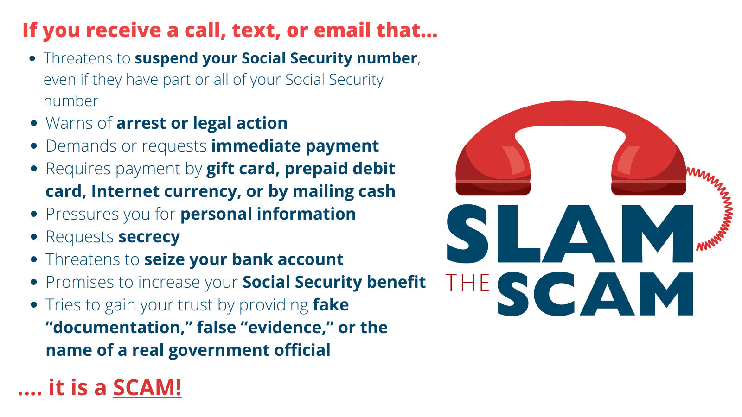

Slide 10
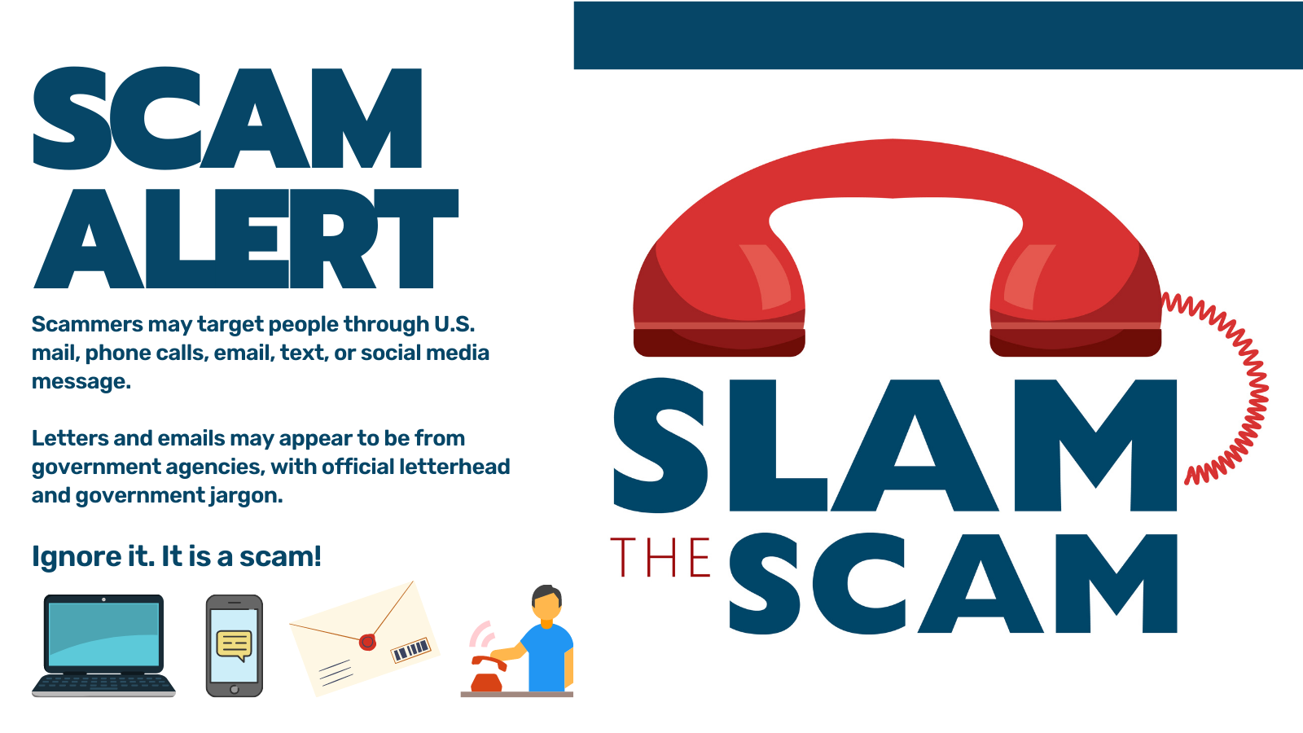
ADD YOUR WEBSITE OR ADD AGENCY NAME IN THIS TEXT BOX
Notes:
Use text box in upper right corner to add website or agency

Slide 11
Become a #SlamTheScam partner
For questions on our #SlamTheScam outreach efforts, reach out to oig.dcom@ssa.gov

